Slide 1

Course Name- Production Technology for Ornamental Crops, MAP and Landscaping
Course Code- 20014400
Presented By- Dr. Mahendra Kr. Yadav
B.Sc. (Ag.) IV Sem. (Production Technology for Ornamental Crops, MAP and Landscaping)

Slide 2
Course Objectives
Identify different types of ornamental and medicinal crops.
Examine various principles of landscaping, uses of landscape trees, shrubs and climbers, production technology of important ornamental crops, etc.
Determine about Demonstrate various Package of practices for loose flowers and their transportation, storage house and required condition for cut and loose flower.
Construct about the various problems with the production technology of medicinal and aromatic plants.
Importance of Processing and value addition in ornamental crops and MAPs produce.
B.Sc. (Ag.) IV Sem. (Production Technology for Ornamental Crops, MAP and Landscaping)

Slide 3
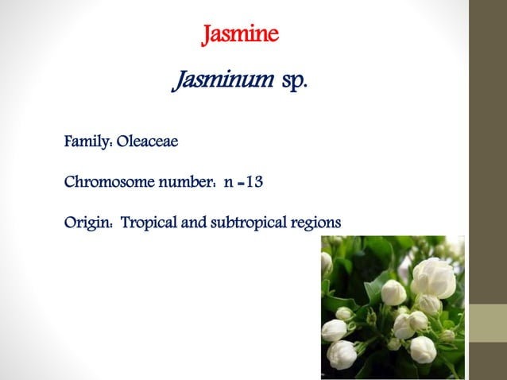
B.Sc. (Ag.) IV Sem. (Production Technology for Ornamental Crops, MAP and Landscaping)

Slide 4
Jasmine
It is one of the oldest fragran, important commercial
flower cultivated in India.
They are mainly grown as climbers, shrubs and rarely as
pot plants.
Garlands are being used for personal adorning by women, making garland, veni preparation and in religious offerings.
Production of perfumed oils and attars.
India exports flowers to Sri Lanka, Singapore, Malaysia and Gulf countries
B.Sc. (Ag.) IV Sem. (Production Technology for Ornamental Crops, MAP and Landscaping)

Slide 5
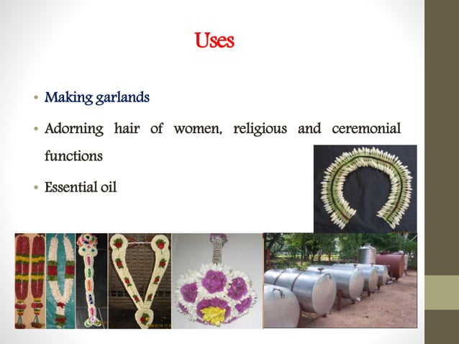
B.Sc. (Ag.) IV Sem. (Production Technology for Ornamental Crops, MAP and Landscaping)

Slide 6
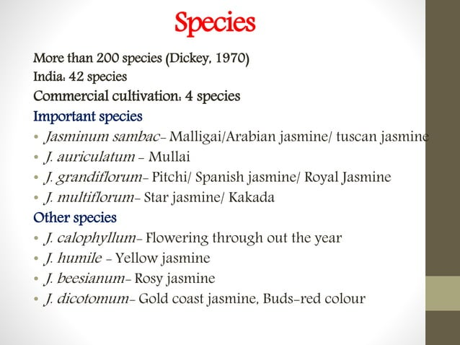
B.Sc. (Ag.) IV Sem. (Production Technology for Ornamental Crops, MAP and Landscaping)

Slide 7
J. auriculatum
Parimullai
CO-1 Mullai
CO-2 Mullai
Others - Long Point, Long Round, Medium Point etc
J. grandiflorum
Arka Surabhi
CO-1
CO-2
J. sambac
Ramanathapuram
Gundumalli
Khoya
₄ Others - Ramabanam, Single Mogra, Kasthurimalli
Varieties
B.Sc. (Ag.) IV Sem. (Production Technology for Ornamental Crops, MAP and Landscaping)

Slide 8
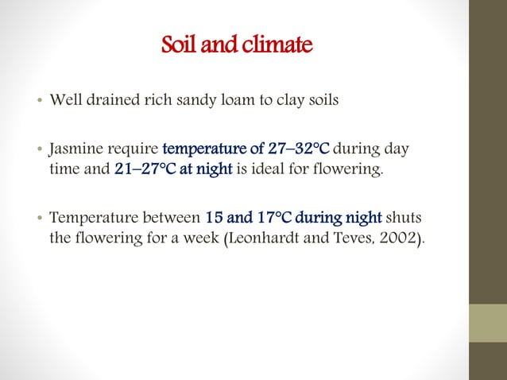
B.Sc. (Ag.) IV Sem. (Production Technology for Ornamental Crops, MAP and Landscaping)

Slide 9
Propagation and planting material
Jasmines are commercially propagated by cuttings
J. auriculatum - Semi-hard wood
J. grandiflorum - Terminal cutting
J. sambac - Terminal and Semi-hardwood cuttings.
IAA (or) IBA treated at 1000 ppm for terminal cuttings and 2500 ppm for semi-hard wood cuttings.
The treatment is quick dip method of the basal cut end
before planting in the medium.
Best rooting medium is sand: Vermiculate: moss at
1:1:1 ratio.
B.Sc. (Ag.) IV Sem. (Production Technology for Ornamental Crops, MAP and Landscaping)

Slide 10
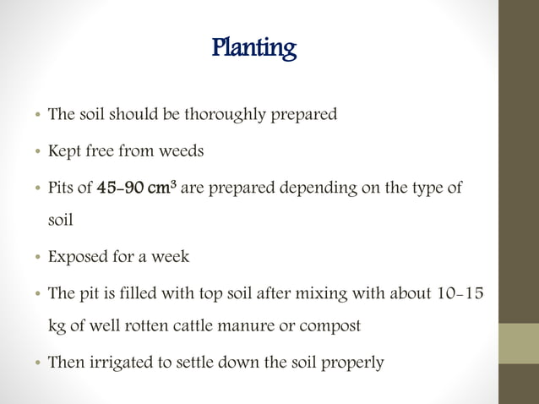
B.Sc. (Ag.) IV Sem. (Production Technology for Ornamental Crops, MAP and Landscaping)

Slide 11
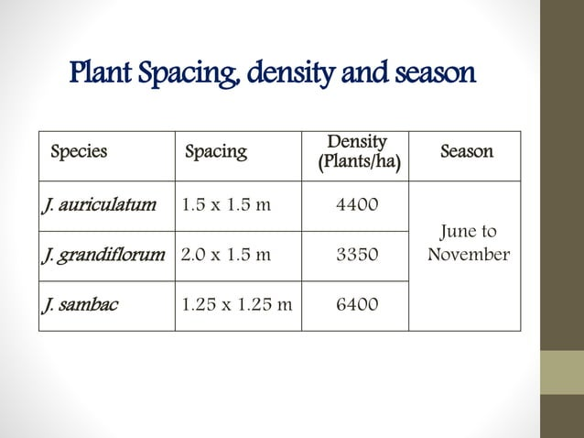
B.Sc. (Ag.) IV Sem. (Production Technology for Ornamental Crops, MAP and Landscaping)

Slide 12
Nutritional requirement
Species | Quantity(g/plant) |  |  | Method
 | N | P₂O₅ | K₂O
J. auriculatum | 60 | 120 | 120 | Six split doses at bimonthly interval
J. grandiflorum | 100 | 150 | 100 | In two split doses first June- July and second dose at December after pruning
J. sambac | 60 | 120 | 120 | Two split doses first at June- July and second at November after pruning
Foliar nutrition
Spraying of zinc 0.25% and magnesium 0.5% before flowering increases the yield of flowers.
Spray FeSO₄ at 5g/lit. at monthly intervals until the chlorotic symptoms 7disappear.
B.Sc. (Ag.) IV Sem. (Production Technology for Ornamental Crops, MAP and Landscaping)

Slide 13
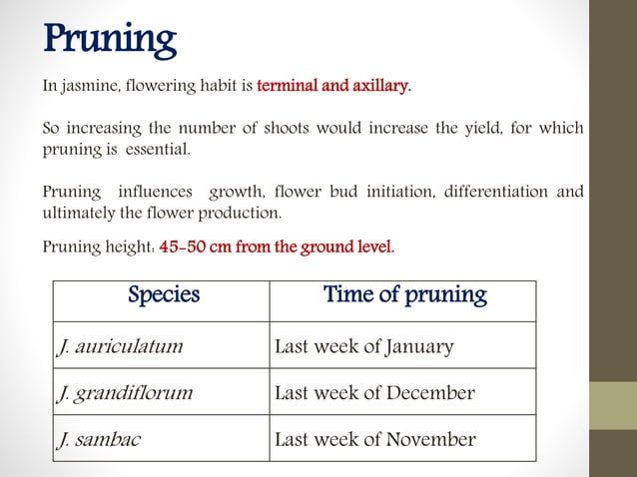
B.Sc. (Ag.) IV Sem. (Production Technology for Ornamental Crops, MAP and Landscaping)

Slide 14
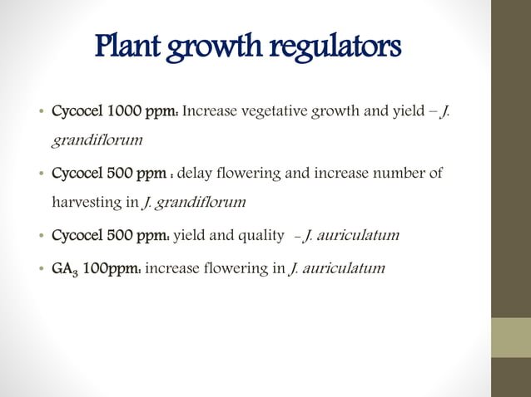
B.Sc. (Ag.) IV Sem. (Production Technology for Ornamental Crops, MAP and Landscaping)

Slide 15
Irrigation
Sufficient amount of moisture in the soil is necessary for proper growth and flowering.
Jasmines can be irrigated once in ten days depending on the soil and climatic conditions.
Weeding
Commonly done manually but is expensive.
Chemical weed control is effective and economical.
Spraying with Oryzalin 1 or 2 application is effective.
Mulching also reduce weed population.
B.Sc. (Ag.) IV Sem. (Production Technology for Ornamental Crops, MAP and Landscaping)

Slide 16
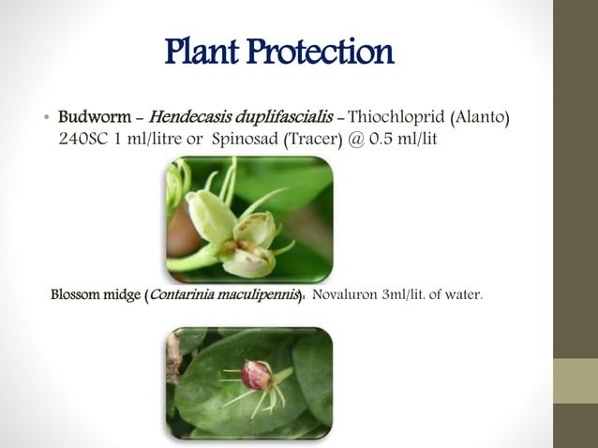
B.Sc. (Ag.) IV Sem. (Production Technology for Ornamental Crops, MAP and Landscaping)

Slide 17
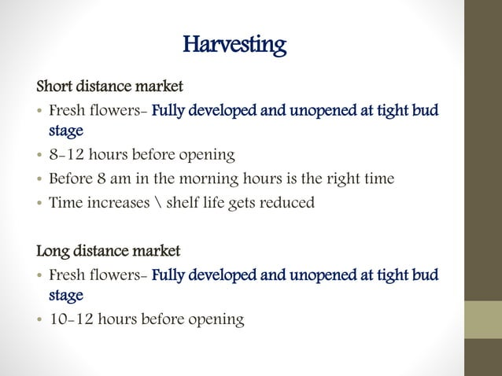
B.Sc. (Ag.) IV Sem. (Production Technology for Ornamental Crops, MAP and Landscaping)

Slide 18
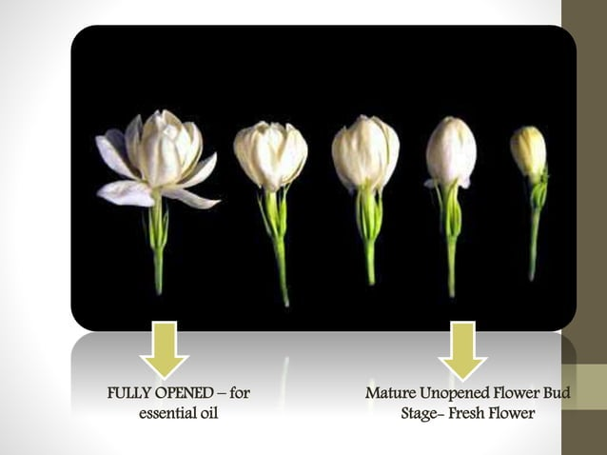
B.Sc. (Ag.) IV Sem. (Production Technology for Ornamental Crops, MAP and Landscaping)

Slide 19
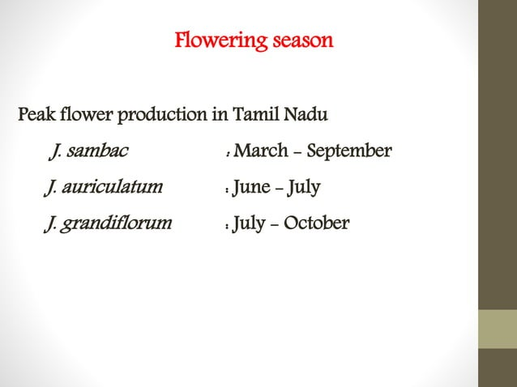
B.Sc. (Ag.) IV Sem. (Production Technology for Ornamental Crops, MAP and Landscaping)

Slide 20
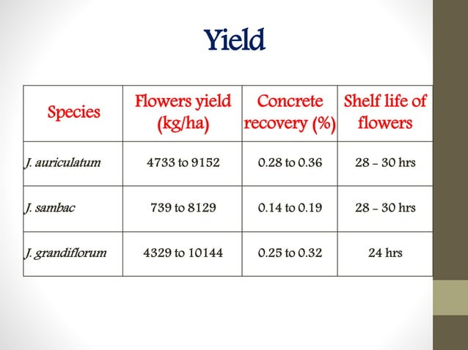
B.Sc. (Ag.) IV Sem. (Production Technology for Ornamental Crops, MAP and Landscaping)

Slide 21
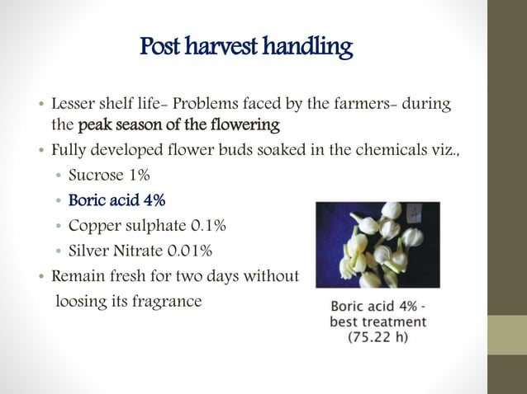
B.Sc. (Ag.) IV Sem. (Production Technology for Ornamental Crops, MAP and Landscaping)

